Slide 1
Bank Marketing Analysis
MADHUMITA S
March 10,2019

Slide 2

Problem Statement
The Portuguese Bank Institution had run a direct marketing campaigns(phone calls) in the past, making sales calls for a term-deposit product. The marketing team wants to launch another campaign, and they want to learn from the past one.
This project aims to solve this problem using Machine Learning algorithm(supervised model) in R and achieve the following goals:
Reduce the marketing cost by X% and acquire Y% of the prospects (compared to random calling), where X and Y are to be maximized.
Present the financial benefit of this project to the marketing team.

Slide 3
Model Building
LOGISTIC REGRESSION
It’s a classification model though name is logistic regression.
Outputs probability [0,1]
SUPPORT VECTOR MACHINE
Used for both classification and regression.
Finds a hyperplane that divide a dataset into two classes.

Slide 4

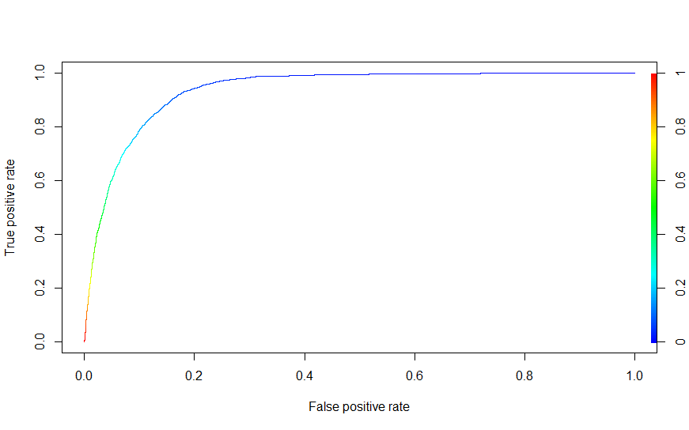

RESULTS/OUTCOMES
Logistic regression
Accuracy =0.9117219
Misclassification rate =0.08827814

Slide 5
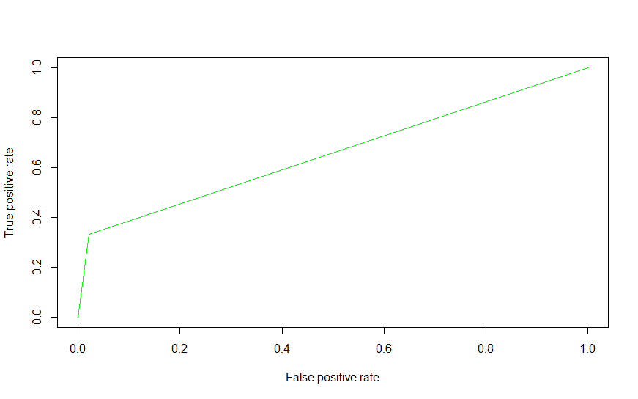
Support Vector Machine
KS statistic = 0.3106642
RESULTS/OUTCOMES

Slide 6

Thank you

